Slide 1
Shopping basket analysis
Sheharaz Abdul Majeed Sheikh

Slide 2
Steps
Split, tidy and Analysis
Association Analysis- Web
Association Analysis- Branch

Slide 3

Split data, remove NA and Analysis
Two entities identified - Web and Branch separately analyzed.
Remove NA
Perform split and cast as transactions.
Association analysis for items with the same basket id

Slide 4
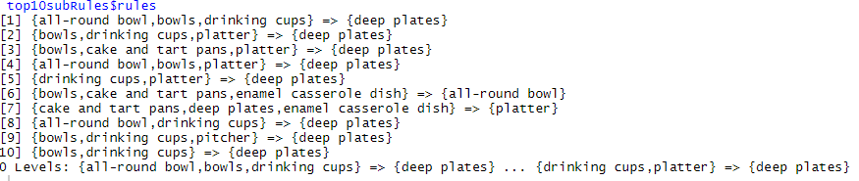
Association Analysis- Web
Items in rules with high lift can be recommended together in the online(Web) store based on the online shopping cart items. This would enhance shopping experience for the user.
Top 10 rules according to lift value are as shown in figure.
Item “deep plates” is observed to be frequently repeated among top rules.

Slide 5
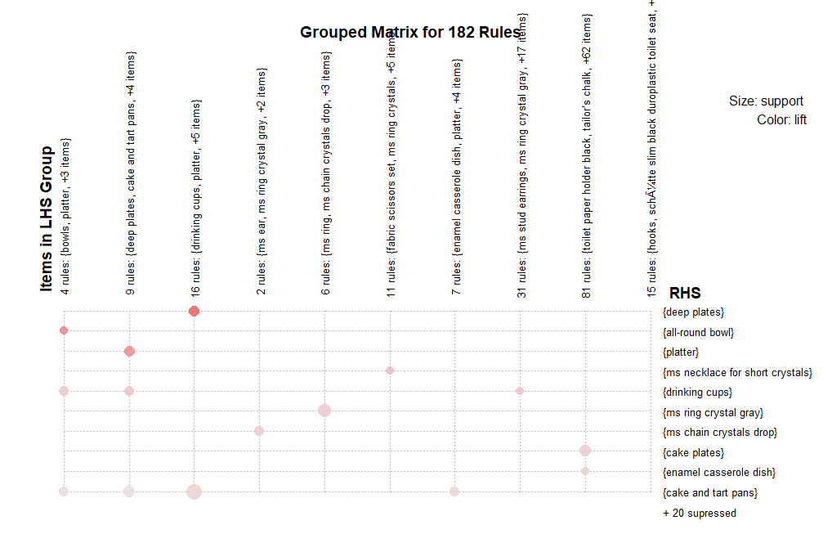

Slide 6
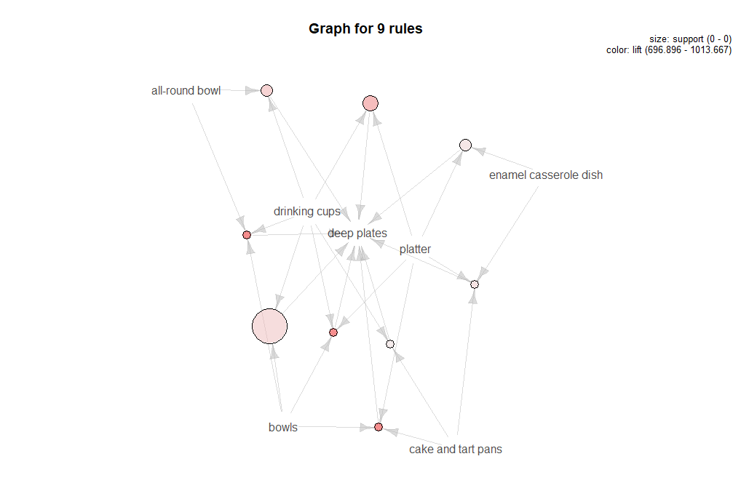
Rules for the item “deep plates”

Slide 7
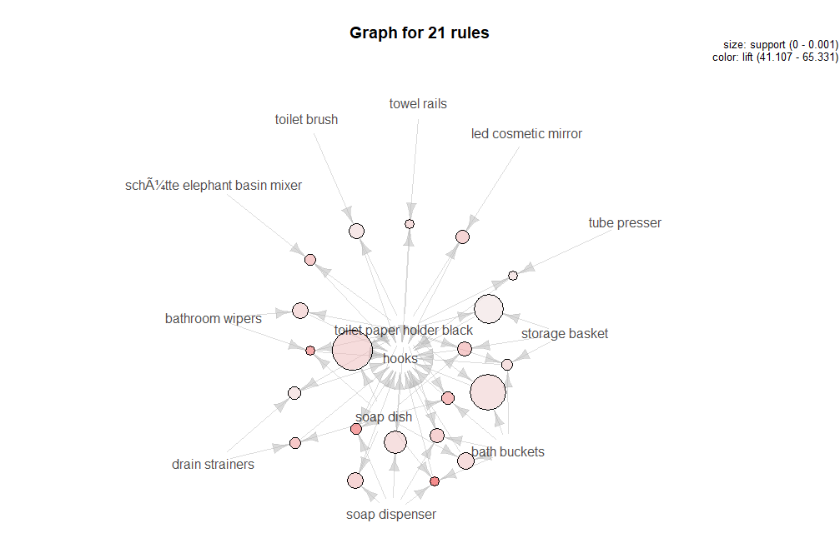
Rules for the item “hooks”

Slide 8
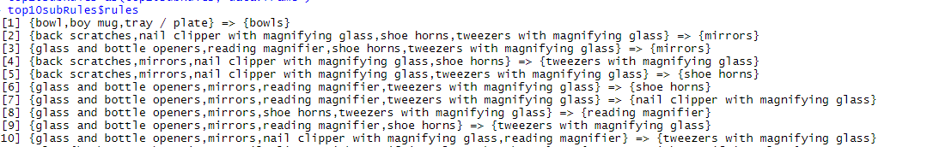
Association Analysis- Branch
Items in rules with high lift can be kept in the same section of the store. This would help customers to easily access the items and have good shopping experience.
Top 10 rules according to lift is as shown in figure.
Item “tweezers with magnifying glass” is observed to be frequently repeated among top rules.

Slide 9
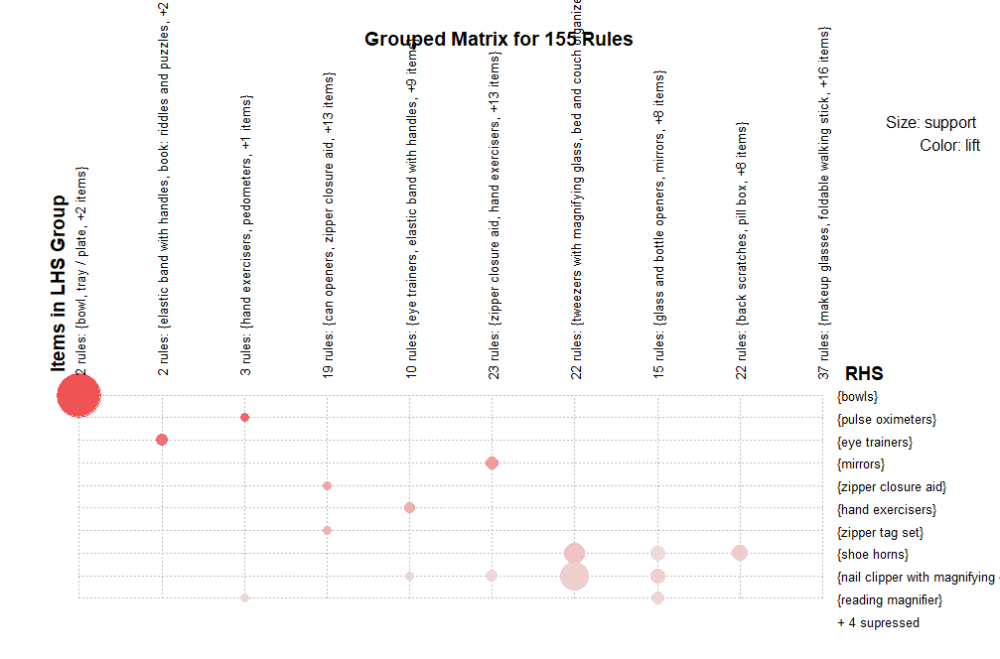

Slide 10
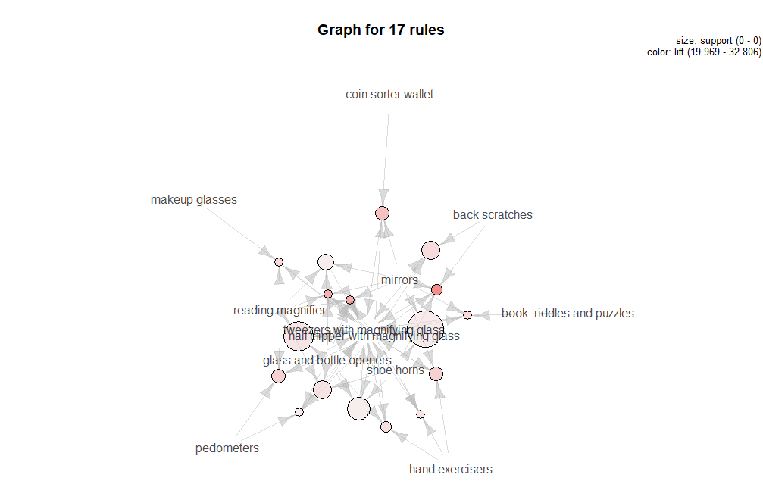
Rules for the item “tweezers with magnifying glass”

Slide 11
Thank you!

